Slide 1



Slide 2
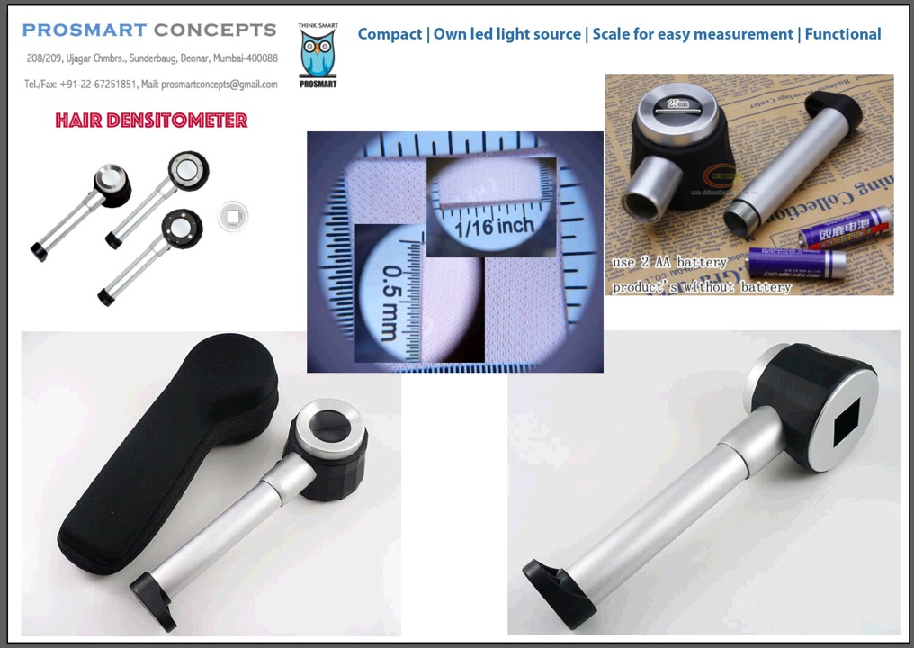
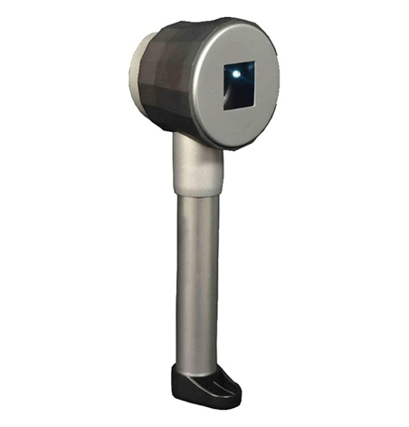
RS. 500/-
Hair Densitometer
Hsn: 90291090

Slide 3
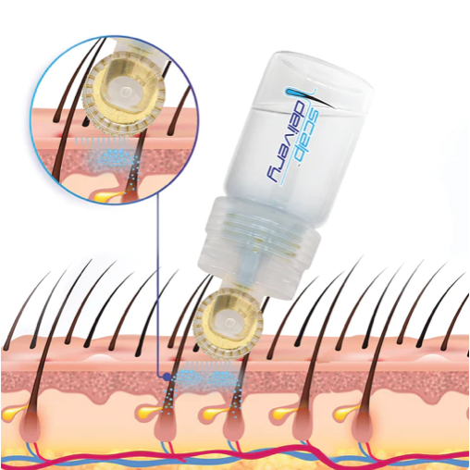
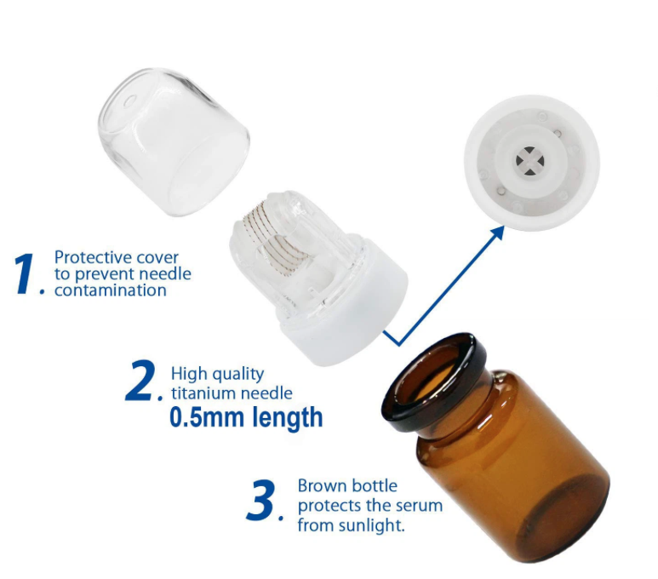
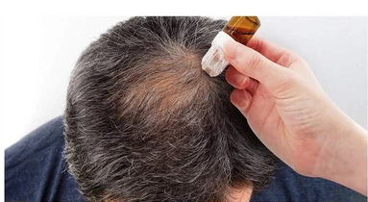
Hydraroller Hair delivery system
RS. 260/-
Hsn: 9018
https://scalpdelivery.com/products/medical-grade-hydra-roller-advanced-serum-vial-new-box

Slide 4
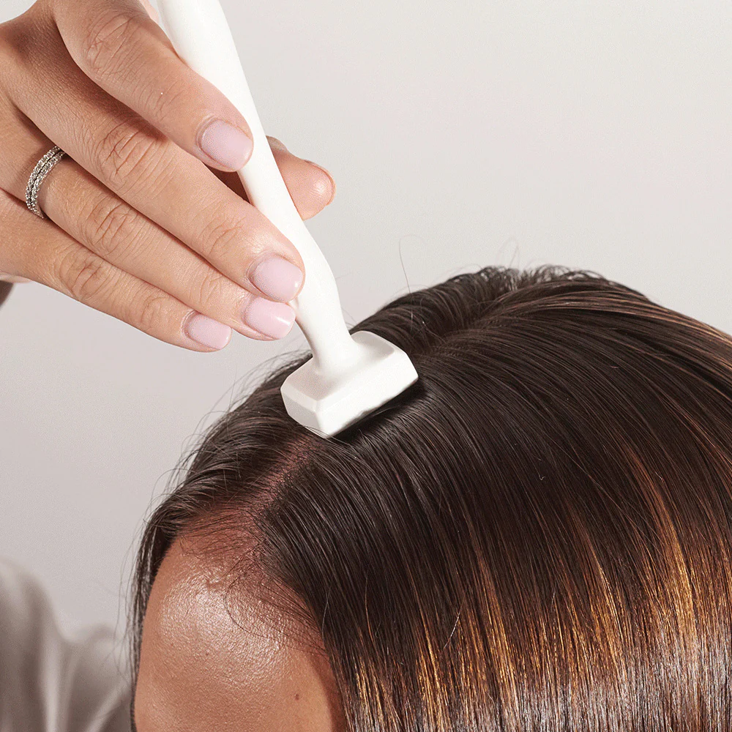
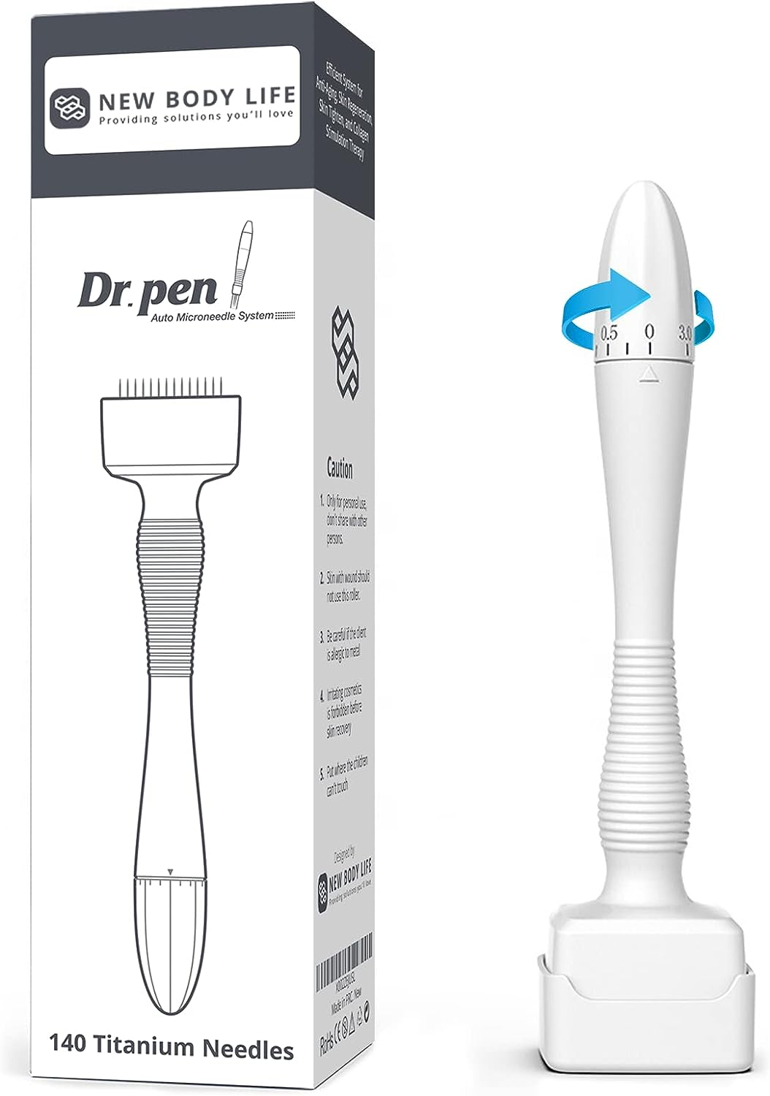
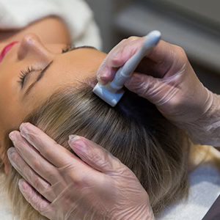
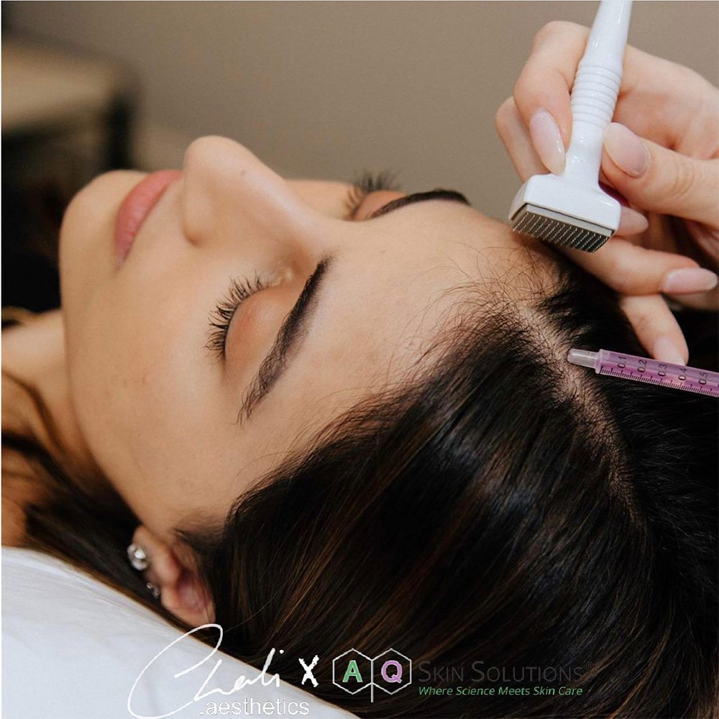
DERMA STAMP
Localised
Adjustable Length
microneedling
RS. 595/-
Hsn: 9018

Slide 5

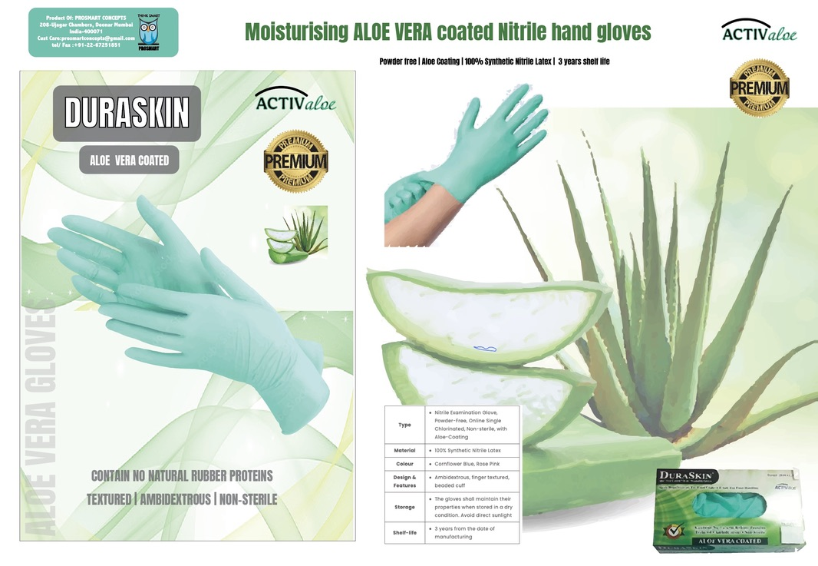
RS. 275/-
BOX OF 50 PCS
Hsn: 9018
Aloe vera gloves – PREVENTS CONTACT DERMITITIS * MOISTURISES YOUR HAND FOR LONG DURATIONS NATURALLY

Slide 6
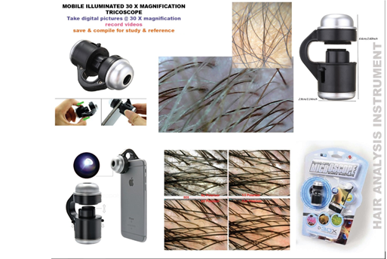

RS.310/-
Hsn: 90291090
Mobile Illuminated 30x magnification Tricoscope

Slide 7

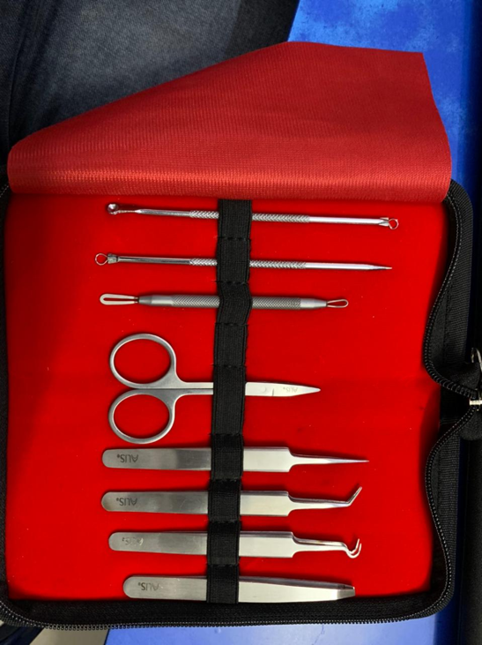
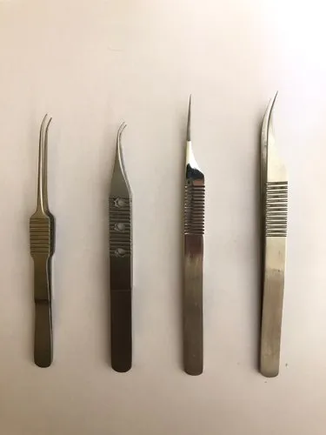
Hair Transplant forceps kit
RS. 390/-
Hsn: 9018

Slide 8
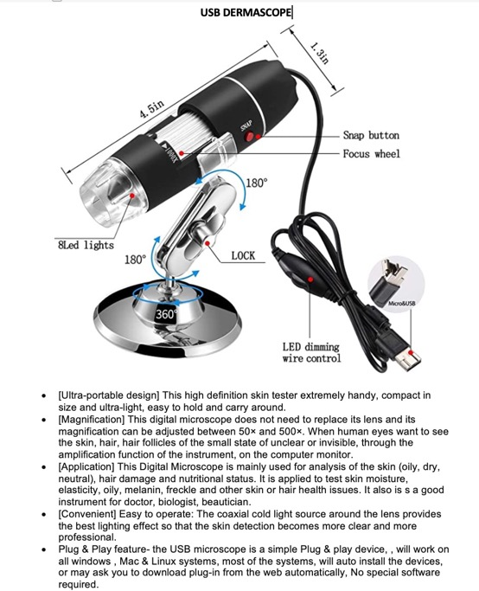
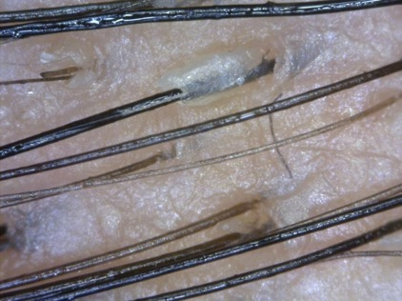
RS. 895/-
Hsn: 90291090
Digital Microscope – PC & Mobile interface

Slide 9
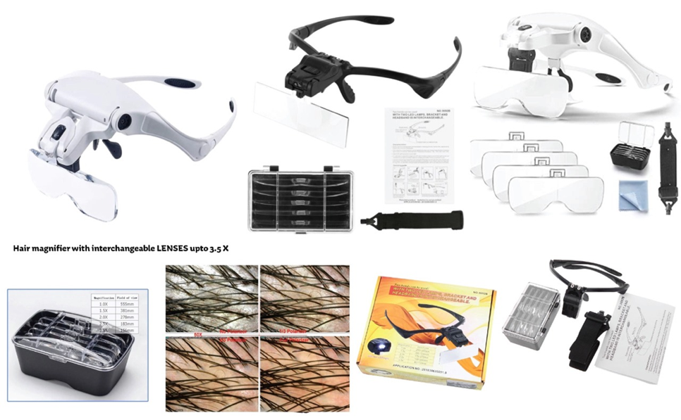

RS. 550/-
Hsn: 90291090
Hair magnifier with Interchangeable lenses upto 3-5X

Slide 10


RS. 250/-
Hsn: 9018
Derma Roller –

Slide 11
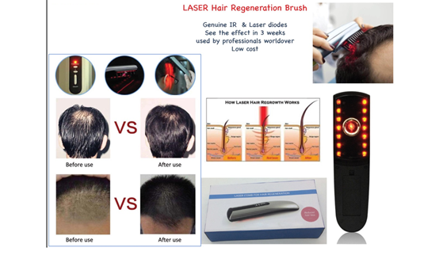

RS. 795/-
Laser Hair Regeneration Brush
Hsn: 90291090

Slide 12
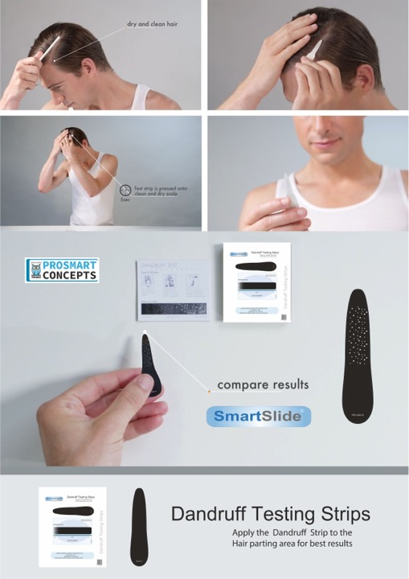
Dandruff Testing strips
RS. 6/-

Slide 13
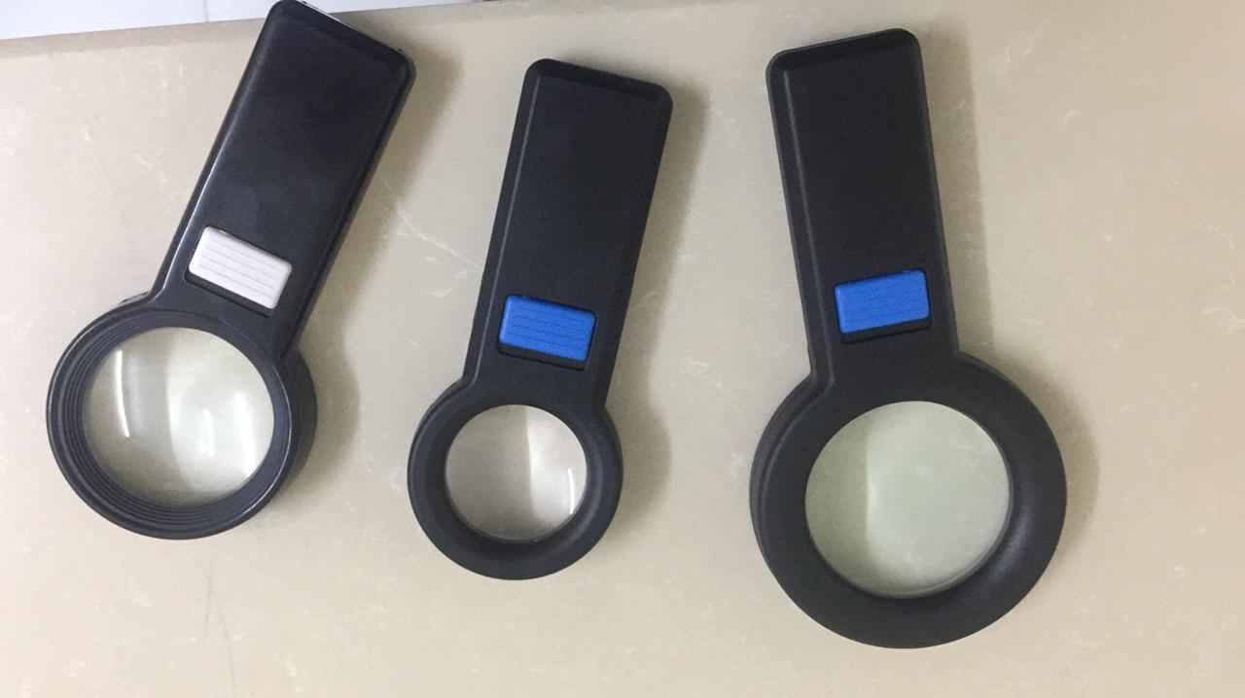
Different sizes of LED magnifiers
RS. 250/-
Hsn: 90291090

Slide 14

PRP KIT
Rs 550/-
Hsn: 9018
Platelet Rich plasma injection therapy

